Slide 1
dewproject.eu
Change Management
Partner: IRL

Slide 2
Objectives & Goals
At the end of this module you will be able to:
“The snake which cannot cast it’s skin has to die. As well the minds which are prevented from changing their opinions; they cease to be mind.”
Frederich Nietzche
Understand Effective Leadership is Effective Change Management
Recognize the Complexity of Change Management
Embrace the idea that Change needs to be managed and always holds Entrepreneurial Opportunity
Create a Change Management Plan for your own business

Slide 3
EntreComp Framework – Resources Area
COMPETENCE | PROFICIENCY LEVEL - FOUNDATION | PROFICIENCY LEVEL - INTERMEDIATE | PROFICIENCY LEVEL - ADVANCED
Self-awareness and self-efficacy | Learners trust their own ability to generate value for others | Learners can make the most of their strengths and weaknesses. | Learners can compensate for their weaknesses by teaming up with others and by further developing their strengths.
Motivation and perseverance | Learners want to follow their passion and create value for others. | Learners are willing to put effort and resources into following their passion and create value for others. | Learners can stay focused on their passion and keep creating value despite setbacks.
Mobilising resources | Learners can find and use resources responsibly. | Learners can gather and manage different types of resources to create value for others. | Learners can define strategies to mobilise the resources they need to generate value for others.
Financial and economic literacy | Learners can draw up the budget for a simple activity. | Learners can find funding options and manage a budget for their value creating activity. | Learners can make a plan for the financial sustainability of a value creating activity.
Mobilising others | Learners can communicate their ideas clearly and with enthusiasm | Learners can persuade, involve and inspire others in value-creating activities. | Learners can inspire others and get them on board for value-creating activities

Slide 4
Index
Change Management
Unit 1: Understanding Change Management
Unit 3: How to Manage Change
Section 1: Change v Change Management
Section 2: The Nature of Change in Business
Section 3: Change Management is Nothing New
Section 4: The Complexity of Change Management
Section 5: Internal & External Change Drivers
Section 1: Getting Started! SMART Goal Setting
Section 2: Kotter’s Eight Stage Change Management Process
Section 3: The Importance of Leadership
Unit 2: Why is Change Management Difficult
Section 1: Why is Change Management Difficult
Section 2: Management V Staff Conflict

Slide 5
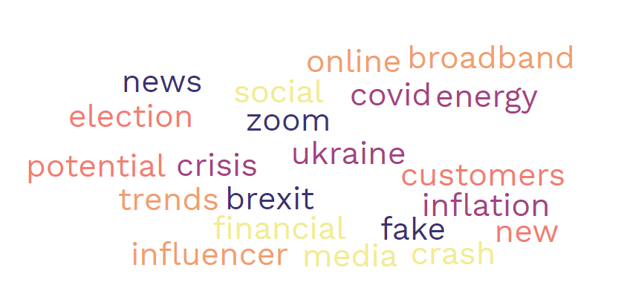
1. What is Change Management?
Change in business as in life has always been the only Constant.
In the third decade of the 21st Century the pace of Business Change is accelerating at a pace unprecedented in human history.
Your Business cannot avoid Change, but Change Management
involves more than reacting to this reality.
Change management is the process of planning, implementing
and solidifying changes in an organization.
Change Management is a planned structured Business Tool to
realize the future vision of your Business.
Change Management is an Entrepreneurial Effort to meet Entrepreneurial Opportunity.

Slide 6
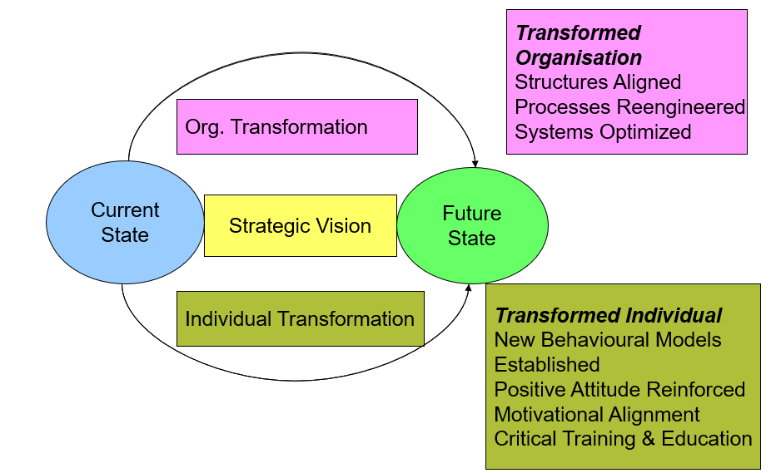
1. The Nature of Change in Business
The only thing that does not change in business is the need for change.
Businesses need to constantly look at new ways of doing things because if they do not, they become uncompetitive & ‘die’.
In this respect businesses need to adopt the philosophy of continuous improvement & be constantly looking for ways to improve their processes.
The Change Management Vision

Slide 7
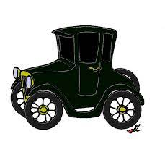
1. Change Management is Nothing New
The Disciplines of Engineering and Psychology particularly from the late 19th Century period of urbanisation and Industrialisation began to come together to help describe how change happens and how to manage change.
Scientific Management as developed by Frederick Taylor in 1911 is a famous example of Change Management in Practise.
Production efficiency in a shop of factory could be greatly enhanced by close observation of the individual worker and elimination of waste time and motion in his operation.
Taylors ideas has strongly influenced Change Management thought and business model development for well over 100 years.
The Science of Psychology, understanding personnel change, job satisfaction, job security and insecurity, staff retention, morale, productivity and helping individual staff members understand what specific change might -oriented mean to them personally is all part of a psychology-oriented approach to Change Management.
Effective Change Management involves both the Mechanical (Technological) and human dimension. It’s always important to explore how both dimensions might interact in practise when planning new Business change.
In
Get Busy!
Can you name two famous businesses where there is evidence of Scientific Management in Practise?
How might Scientific Management inform Change Management in this popular Irish Fast Food Restaurant Chain?

Slide 8
1. The Complexity of Change Management.
“Change Management is a structured approach to transitioning individuals; teams and organisations from a current state to a desired future state to fully implement a vision and strategy. Change Management is the formal process of organisational change. Change Management means defining and Adopting Corporate Strategies, structures, procedures and Technologies to deal with change stemming from Internal and External Conditions. ” (Anon in Ryerston University 2011).
Structured Approach – Change Management is about structured Planning, not hurried reaction.
People Transition – Change Management is a process of Transition of People From Practise A (Which is often well established, perhaps quite successful and comfortable to Practise B (Which involves ambition, risk and the unknown) . It fundamentally is concerned with all the uncertainties of People Management.
Formal Process – Effective Change Management needs to be a formalised process, informal organic organisational change where change in an organisation just happens over time or as a natural reaction is not Change Management.
Definition and Adoption – A major key to successful Change Management is Communication. Clear Definition and communication of the Challenge to be Addressed and How, will go a long way towards addressing fears and getting the necessary level of buy-in and adoption necessary for success.

Slide 9
1. Internal & External Causes of Change
There are two main Drivers of Business Change – Internal & External
Internal Change Agents
External Change Agents
Technology
Operational Deficiency
Communication Deficiency
Peer Experience
Staff Changes
Profit Margin Changes
Opportunity
Technology
Changing Consumer Culture & Expectation
Economic Boom & Bust
Migration
Brexit
Secularisation

Slide 10
2. Change Management is Difficult
Change management while the lifeblood of business survival, is very difficult.
In 2006 Harvard Business Review found that 66% of change initiatives fail to achieve their desired business outcomes (Anon. in Ryerson University, 2011).
Day-to-Day stresses of business practise, orders to be filled, customers to be satisfied leaves little space for the perceived luxury of actually Managing Change as against scrambling to react to it.
For any small business in particular, theres usually a more immediate task to take priority.
Managing Change requires honest, unemotional logic-based choices which for many leadership groups or individuals is not easy to channel.
Change Management is a PROCESS not an event.
Get Busy!
Thinking of your Enterprise or an enterprise you are familiar with, suggest Digitisation Change Needed and the blockages in implementing them. Where possible share with a learning colleagues.
Business Model
Business Deficiency
Change Management Solution
Change Management Impediment

Slide 11
2. Staff v Management Conflict
Management might see Change in a Linear Fashion
Current State
Transformation
State
Future
State
Staff might well View Change Differently
Future
State
Current State
Transformation
State

Slide 12
3. How to get Started! SMART Goal Setting
SMART goals is a straightforward affordable in both time and resources way to get any Change Management process started
Very useful in framing and most importantly the communication of Definition & Adoption
Makes it easier to help your organization prepare, conform, and accept the change in a streamlined way throughout the change process
All about fast comprehension and acceptance
Can be used as a Stand Alone change structure or be built on with a more complicated framework
S
Be able to describe exactly what the Change Objective is
M
All Business Change should be tangible so all stakeholders can see, touch and understand the change.
A
The time allowed to achieve the change objectives should be realistic - allowing all stakeholders enough time to carry out their role in the process.
R
T
Specific
Measurable
Achievable
Realistic
Time Bound
Unachievable Targets don’t help buy-in to the process and lead to rapid disengagement and disillusionment with the Change Management Process
A Change Management process without timebound can easily drift back into wishful thinking.

Slide 13
Get Busy!
‘Bridie’ runs a long-established hairdressers in a small town in the Republic of Ireland. Typical of many similar Irish businesses her business does not yet have a Social Media presence.
Complete the SMART GOAL Table below for this project. Where possible share with a learning colleagues.
‘Bridie’s Hair Saloon’ Social Media Adoption Project Smart Goals
S | Specific
M | Measurable
A | Achievable
R | Realistic
T | Timebound

Slide 14
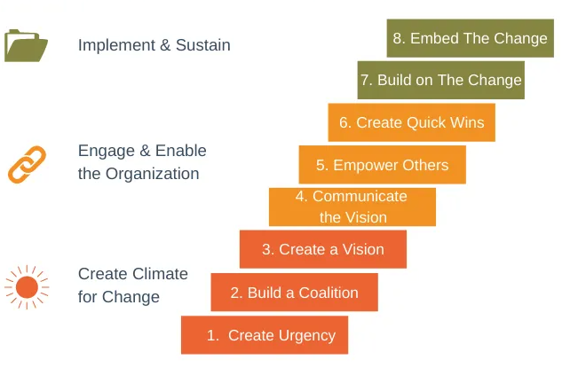
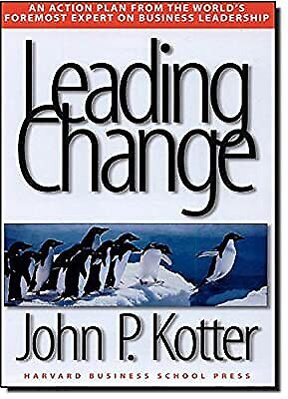
3. Kotter’s Eight Stages of Change Management
Meaningful and hugely popular theory chosen offering a framework wide and detailed enough to direct and manage the potential pitfalls of Change Management
Offers a practical roadmap to follow
Scalable, if followed properly can bring structure to any Change Management project

Slide 15
3. The Importance of Effective Leadership
Managing change is important …
But for most organisations, the much bigger challenge is leading change.
Only leadership can blast through the many sources of corporate inertia.
Only leadership can motivate the actions needed to alter behaviour in any significant way.
Only leadership can get change to stick by anchoring it in the very culture of an organisation.
Leading Change, John P. Kotter

Slide 16
Summing up
Change Management is a structured Business Tool to Realize the Future vision of your Business.
Successful Change Management follows a fully embraced and Step-by-Step Process.
All Businesses will Change but Change Management takes Control of this Process as an Entrepreneurial Opportunity.
Effective Change Management is Effective Leadership.
The Process of Change Management is Complex and Challenging but if avoided this can have very negative consequences for your business.

Slide 17
Thank you!
dewproject.eu

