Slide 1
dewproject.eu
Managing Digital Team
Partner: IDP sas

Slide 2
Objectives & Goals
At the end of this module you will be able to:
Communicate in a clear and effective way to your digital team
Recognize the most efficient digital tools for team management
Adopt an OKR methodology within your business and team
Guarantee the work-life balance of your employees
Compensate weaknesses by teaming up with others
Inspire others and get them on board for value creating activities
Advanced level of the EntreComp competence
SELF-AWARENESS & SELF-EFFICACY
Advanced level of the EntreComp competence
MOBILISING OTHERS

Slide 3
Index
Managing Digital Team
Unit 1: Smart working
Unit 3: Leadership
Section 1: Definition
Section 2: Golden rules
Section 3: ICT tools for Management
Section 1: Smart and digital leadership
Section 2: Challenges
Section 3: How to motivate a digital team
Section 4: Productivity-boosting strategies
Unit 2: Team Management
Section 1: OKR methodology
Section 2: Tasks distribution
Section 3: Digital tools for communication
Section 4: Work life balance in a digital team

Slide 4
1. Smart Working – Definition
Smart working has been defined as:
A new way of working based on flexible work arrangements and an extensive use of information technologies that support employees to potentially work in any time and space
An agile and dynamic way of working that leads to high performance, increased productivity, and improved job satisfaction that result is a “triple-win” configuration for customers, employees, and organizations
Using digital technologies to improve organizational effectiveness requires a broader intervention in management and leadership capabilities. Keep in mind that the essential elements for and effective and efficient smart working are:
AGILE APPROACH TO WORK
CENTRALITY OF THE EMPLOYEES
INNOVATION
COLLABORATIVE ECOSYSTEM

Slide 5
1. Smart working – Golden rules
Have the necessary platforms, apps and resources. Assess the team necessities and hire or install the services needed for the correct execution of tasks;
Keep a fair workload distribution and make sure that every team member knows which tasks correspond to her/him;
Use video conference platforms periodically, to clarify tasks and information, also fostering a healthy and dynamic work atmosphere within the team;
Keep communication open, assertive and effective. Some Tips:
- Always answer emails and messages to confirm that you received them
- Include the subject in every email to speed their classification and management
- Keep workmates posted and clarify any misunderstanding if needed
Plan meetings in advance in order to guarantee better effectiveness and organisation and avoid time incompatibilities

Slide 6
1. Smart Working – ICT tools for management
There is a whole array of ICT tools that can improve business and team management in smart working. Here some of the most useful:
Even though a specific platform for each task would be optimal, platforms that encompass all functions are still a great option:
Dropbox
Monday.com
It is one of the most known cloud storages apps. It allows users to save and share files from the users’ own virtual hard drives, so files are safe and accessible from any compatible device.
It allows for easy planning and management for most of the tasks of a business within the same workspace. This includes project and task management, CRM, marketing, design, human resource etc.
Team Viewer
ClickUp
It enables remote access to other devices. It allows users to share and control their desktops, make online meetings, videoconferences and transfer files.
An all-in-one that offers project and file management, task lists, email, messaging, tracking and follow-up etc. It is completely customisable, letting users import information from other projects and managers.

Slide 7
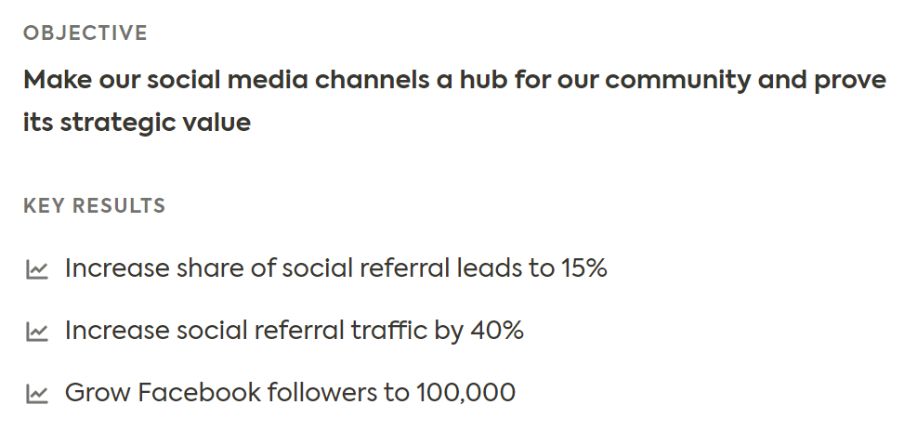
2. Team management – OKR Methodology
Objectives and Key Results (OKR) is a modern method for goal and people management, which particularly suits for digital team and digital business, since:
It is based on the idea that motivation comes through ownership and self-organization
It allows teams to react to changes in the market on their own initiative, to be self-organized and autonomous
OKRs shall be clear to everybody within the team and are typically set every quarter to react quickly to changes.
OBJECTIVES
Example
Source: https://mooncamp.com/blog/okr-mbo/
Objectives are determined by managers and represent the overall qualitative goals of the company.
KEY RESULTS
Key Results are determined by the employees in a bottom-up approach; they represent the quantitative objectives of the team.

Slide 8
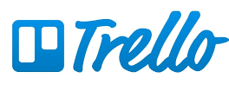
2. Team Management – Tasks distribution
A correct task distribution is fundamental to guarantee a proper business management and improve workers’ performance, in particular in smart working contexts. These are some of the ICT tools which can help project planning and team management:
Asana
It offers details on tasks and projects and implements communication, organisation and planning in order to achieve team success.
Trello
It organises tools via Kanban tables, which allows for an enjoyable view of teamwork management.

Slide 9
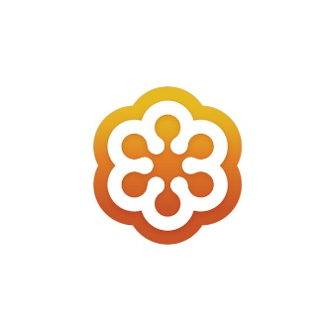
2. Team management – Digital tools for communication
In a digital team, it is essential to be in constant communication to perform all daily tasks in an effective and syncronised way. Here some tools which can help to create a central place for communication:
VIDEO CONFERENCE SERVICES
Skype is an optimal choice for any company. Users can video call and chat via PC, tablets and smartphones. It gathers up to 50 people.
In the free version, Zoom gathers up to 100 participants but the duration of a session is limited to 40 minutes. The Pro version costs 13.99 euros per month and per moderator.
Cisco Webex provides capabilities including online meetings, team messaging and file sharing. Users can join video conferences from a desktop or mobile app. A web version of Webex, with less feature, is available as well.
Jitsi is a free open source tool. Users can create a meeting without needing an account and invite participants sharing a URL.
MicrosoftTeams gathers up to 250 participants and online events with up to 10,000 participants. In addition to video conferencing, Teams offers extensive virtual collaboration features, including Office 365 integration.
Slack is a messaging app for companies, which enables conversation grouping, sorting them in threads or by topic for easier access to any team information available.
GoToMeeting is an online meeting, desktop sharing, and video conferencing software package. It is available for the computer, but also as an app for smartphones and tablets.

Slide 10
2. Team management – Work Life balance in a digital team
Major flexibility in working schedule and the use of technologies facilitate the blurring of the line between work and personal life. How can employees’ work-life balance be protected and improved in smart working?
Offer a flexible working time model
Clearly communicate time off for vacation time, community initiatives, health insurance and parental leave
Let employees take all their vacation days and give them weekends off
( i.e., no answering emails, being able to switch the phone off at night)
Encourage employees to commit to enjoying some downtime every day
Organise health and wellbeing programmes
(e.g., providing vouchers for a local gym and arranging meditation classes)
Support social and team-building activities
Show that mental health and wellbeing is taken seriously
Encourage communication and make employees feel comfortable talking about personal issues or mental health
GET BUSY
Monitor your employees’ workload regularly.
If you realize that they constantly need to work extra-time, make adjustments.
WHY TO DO THAT?
To prevent costly staff turnover happening on a regular basis
To boost productivity
To improve the quality of results

Slide 11
3. Leadership – Smart and digital leadership
A leader motivates, stimulates, strengthens, activates and guides people
Within the team, a leader should construct shared meanings of change, a key factor for succeeding in the desired change
A SMART LEADER
A DIGITAL LEADER
Fosters collaborative and open relationships
Empowers employees through delegation mechanisms, education and training
Facilitates knowledge sharing
Meets employees expectations and pays attention to their emotions
Works ethically, overcoming obsolete command and control styles
Explores how information technology (IT) can make the organisation more competitive or customer-led
Leads the team through change to make digital a central part of the business’ operations and culture

Slide 12
3. Leadership – Challenges
For a smart leader, overall flexibility may lead to:
A need to adopt more coached-oriented behaviours, due to the increased autonomy and job demand that smart working may place on employees
Difficulties in supervising
Feelings of isolation and overload
To face these challenges, a smart leader should support employees in the development of strong intrinsic motivation and self-determined behaviours.

Slide 13
3. Leadership – How to motivate a digital team
To mobilise and inspire others, a leader shall keep high the motivation of the team. How?
Providing tips and tricks to improve self-motivation
E.g., see possible difficult tasks, lack of indications and immediate feedbacks - which may be frequent in smart working - as something to master rather than something to be scared of.
Providing external inputs to boost motivation.
Behind higher salary, promotion etc., motivation factors are:
- Inform the team about the results
- Provide feedbacks and congratulations
- Listen to employees’ suggestions and demonstrate that their opinion counts
Involve the team in the making-decision process so to align individual and organizational values

Slide 14
3. Leadership – Productivity-boosting strategies
Studies confirm that smart work boosts productivity. However, there are some factors that may put at risk the employees’ productivity:
Major exposure to distractions
Lack of external pressure and consequent tendency to procrastinate
Lack of self-efficacy and self-motivation
To mitigate these factors a good leader supports employees in:
Reminding that focus is a skill that can be improved with practice and perseverance
Providing tricks and tips to improve employees’ self-efficacy. For example, suggest them how to set smart goals:
Consider the overall team goals
Align working goals with your life goals
Follow your natural working rhythm
Consider the time when energy levels peak through the day
Quiet time for goal setting and review
Do not forget the Pareto Principle:
80 % of results come out of 20% of our actions

Slide 15
Summing up
Being a leader in a digital team can lead to several challenges (e.g., difficulty in supervising); these can be overcome by supporting employees in the development of strong intrinsic motivation and self-determined behaviors.
To work in a digital team there are some golden rules, such as:
Fair workload distribution;
Open communication;
Select and use the most appropriate platforms.
The Objectives and Key Results (OKR) methodology for goals and people management is the most suitable within a digital team.
Work life-balance and well-being of the employees should never be underestimated, particularly in a digital team.
Each digital team should have a smart and digital leader, who explores how IT tools can make the organisation more competitive and makes digital a central part of the business’ operations and culture.

Slide 16
Thank you!
dewproject.eu

