Slide 1
dewproject.eu
Business Literacy
Partner: LWL/IHF

Slide 2
Objectives & Goals
At the end of this module you will be able to:
Understand the key importance of finance for entrepreneurship and their link
Understand the concept of cash flow
Manage your cash flow cycle
Forecast your cash flow
Understand pricing for your enterprise

Slide 3
EntreComp Framework – Resources Area
COMPETENCE | PROFICIENCY LEVEL - FOUNDATION | PROFICIENCY LEVEL - INTERMEDIATE | PROFICIENCY LEVEL - ADVANCED
Self-awareness and self-efficacy | Learners trust their own ability to generate value for others | Learners can make the most of their strengths and weaknesses. | Learners can compensate for their weaknesses by teaming up with others and by further developing their strengths.
Motivation and perseverance | Learners want to follow their passion and create value for others. | Learners are willing to put effort and resources into following their passion and create value for others. | Learners can stay focused on their passion and keep creating value despite setbacks.
Mobilising resources | Learners can find and use resources responsibly. | Learners can gather and manage different types of resources to create value for others. | Learners can define strategies to mobilise the resources they need to generate value for others.
Financial and economic literacy | Learners can draw up the budget for a simple activity. | Learners can find funding options and manage a budget for their value creating activity. | Learners can make a plan for the financial sustainability of a value creating activity.
Mobilising others | Learners can communicate their ideas clearly and with enthusiasm | Learners can persuade, involve and inspire others in value-creating activities. | Learners can inspire others and get them on board for value-creating activities

Slide 4
Index
Unit 1: From business idea to financial sustainability
Section 1: Profit & Profitability
Section 2: Revenues and costs
Section 3: Access to finance
Unit 3: Pricing
Unit 2: Cash-flow
Section 1: Pricing
Section 2: Pricing strategy
Section 3: Types of pricing strategies
Section 4: Other topics
Section 1: What is cash-flow?
Section 2: What is the Cash Flow Cycle?
Section 3: How to manage your cash flow
Section 4: Cash flow forecasting
Section 5: How do I do it?

Slide 5
1. From business idea to financial sustainability - Profit & Profitability
Profitability is the basic and primary aim of all enterprises and entrepreneurs.
Without profitability, the business will not last long.
Profit and profit making are the preliminary concepts to best define what profitability is and why it matters.
Profit is simply defined as the surplus after deducting costs from revenues.
PROFIT = TOTAL REVENUES – TOTAL COSTS
To summarize, profit is an absolute measure of how profitable a business is.

Slide 6
1. From business idea to financial sustainability - Profit & Profitability
Profitability is the relative measure of profit – how much profit is made compared to total revenues.
This means that calculating profitability looks at profit, revenues and costs in percentage terms rather than the raw absolute amounts.
PROFIT
PROFITABILITY =
x 100
TOTAL REVENUES
By doing so, this index allows comparing enterprises of different sizes or businesses by looking at their levels of profit side by side.
To summarize, profitability represents the percentage of profit generated per unit of currency spent.

Slide 7
1. From business idea to financial sustainability - Revenues and costs
REVENUES
COSTS
Revenues are money income from business’ activities. They are generated by delivering services or selling products in a certain quantity at a given price.
Costs represent the expenditure incurred for resources to produce a good or service during the production process of business’ activities.
There are 4 types of costs:
Fixed cost (FC) – the expenditure on the fixed factors/inputs of activities, (e.g., production: flour for bread)
Variable cost (VC) – the expenditure on variable factors (e.g., labour: the amount of the wage depends on the number of workers employed)
Explicit cost – the money spent by the producer on both fixed and variable components of business’ activities
Implicit cost – the price of self-supplied factors The value of such a cost must be calculated using market value
REVENUE = Price of the Commodity x Quantity of the Commodity
A certain quantity of the commodity is sold over a certain time period
TR = Total Revenue
P = Price
Q = Quantity
Total Revenue = Price x Quantity
(TR = P x Q)
Total Cost = Total Fixed Cost + Total Variable Cost
(TC = TFC x TVC)

Slide 8
1. From business idea to financial sustainability - Revenues and costs
REVENUES
COSTS
Average Revenue (AR) is the total revenue per unit output sold. AR is also equal to the price 🡪 AR = TR / Q = P x Q / Q = P
Marginal Revenue (MR) is the change in total revenue resulting from one unit increase in quantity sold
🡪 MR = Change in Revenues / Change in Quantity 🡪 MR = ΔTR / ΔQ
Example of MR:
€1500 from the sale of 500 earrings 🡪 Revenue for earring until 500 earrings = €3
€1700 from the sale of 600 earrings
MR = (€1700 - €1500) / (600 - 500) = €2
MR = €2 🡪 Revenue for earing after 500 earrings = €2
Average Cost (AC) is the cost per unit of output
AC = Total Cost / Total Output
Marginal Cost (MC) is the extra cost incurred to produce another unit of output
🡪 MC = Change in costs / Change in Quantity 🡪 MC = ΔTC / ΔQ
Example of MC:
€500 to produce 500 earrings 🡪 Cost for earring until 500 earrings = €1
€580 to produce 600 earrings
MC = (€580 - €500) / (600 - 500) = €0.80
MC = 0.80 🡪 Cost for earring after 500 earrings = €0.80
The Break-even Point (BEP) is the level of activities at which the costs of production/implementation equal the revenues for a product/service.
🡪 BEP = Fixed costs / Revenue per unit (P) – Variable Cost per unit

Slide 9
1. From business idea to financial sustainability - Access to finance
Whether it is to set up a new enterprise or to implement new business’ activities developing an existing enterprise, profitability is crucial.
It influences whether a enterprise can:
obtain funding (for example, from a bank or traditional institutions)
attract investors or business angels (alternative financing) to fund its operations
grow its business in general
It represents the best source of access to finance.
The main tool to raise capital for a business idea or secure lending in general is the business plan (BP). It is a document presenting, among other things, the enterprise’s economic and financial views, including profitability. The latter suggests the possibility of returns on investments.
€

Slide 10
Unit 2. Cash Flow - What is cash flow?
Cash flow is very simply the movement of money in and out of your business.
Cash received = inflows e.g. sales or an investment
Cash spent = outflows e.g. wages, rent, paying suppliers
The purpose of cash flow is to establish a picture of what has happened to the cash in your business during a specific period (accounting period)
There are three main cash flow activities:
Operating activities e.g. cash receipts from sales of goods or services or cash payments such as wages
Financing activities e.g. cash receipts from bank loans or repayments of loans
Investment activities e.g. cash receipts from sale of property or payments for purchase of property or equipment

Slide 11
Unit 2. Cash Flow - What is the cash flow cycle?
The cash flow cycle is the way in which cash moves through your business as products/services are manufactured/delivered and sold and payment is received.
The cycle starts from the time you pay your suppliers/bills to the time you receive payment for your goods/service
The shorter the cycle, the more cash your business makes! This is also known as Cash Conversion Cycle (CCC) – this means that the less time your business has cash tied up in inventory the shorter your CCC.
How can I shorten my cash cycle?
Encourage earlier payments
Ensure you have an easy method for customers to pay
Keep invoices simple and clear
Consider small % discounts for early payment
Cash
Receive payment
Purchase
Pay your bills
Operating expenses
Sales

Slide 12
Unit 2. Cash Flow - How to manage your cash flow
Managing your cash flow means that you are managing your working capital which ensures your business runs from day to day.
Cash flow management means that you are tracking the cash coming in to your business and monitoring it in relation to your outgoings e.g. wages, utility bills etc.
If you have a good management system, you can see a overall picture of income versus costs and ensure you have enough cash to pay your bills, yet still ensure you make a profit.
Potential problems:
If you have cash flow problems you may have
Wage delays
Creditor arrears
Reduced profit
Reduced working capital

Slide 13
Unit 2. Cash flow - Cash flow forecasting
What is cash flow forecasting?
A cash flow forecast is an estimate for the amount of cash coming in and out of your business in a specific period (generally one year). When planning your forecast, it is important to be aware of timings so that you can plan for busier and quieter periods.
Why is it important?
A cash flow forecast is an essential part of your business planning because it can help to demonstrate the viability of your business which is very important if you are looking for investment.
Do I need to update my forecast throughout the year?
Yes – if your business performs differently to what was expected, it is very important that you update your cash flow – if it is not up to date, it is of no use to you.

Slide 14
Unit 2. Cash flow - How do I do it?
Follow these simple steps to write the cash flow forecast for your business:
You need an excel/Google sheet with 12 columns (one for each month). Use the rows to show the cash coming in and going out;
Assign a separate row for each type of income or expenditure;
Your Cash inflows rows will show your incomes from your sales, any investments/financing. Your cash outflows rows will show your expenses e.g. wages, rent, utility bills etc.
You will include a row of totals which calculates the cash in and out for each month. You can use the SUM function for this and the total at the end of each month is your monthly closing cash balance;
You will also need other information to complete your forecast:
Your pricing strategy
Sales forecasts
Costs forecasts
Profit and loss forecast

Slide 15
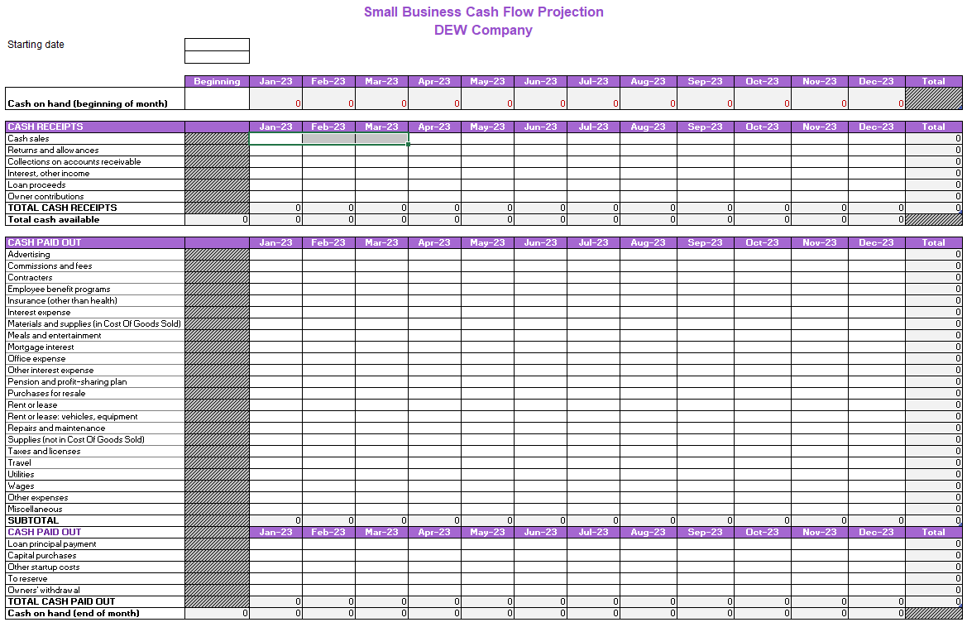
Sample Cash Flow Template

Slide 16
Unit 3. Pricing
Why is pricing important?
Pricing is very important for your business as it shows the value of your product;
You may think that the cheaper your product, the more you will sell but this is not always the case!
Remember your customers will decide whether or not to invest in your product.
An example:
A business is selling a car seat for a baby for €20 – would you buy it for your baby or would you be more likely to spend €100?
Selling cheaply does not necessarily mean more sales.

Slide 17
Unit 3. Pricing strategy
What is pricing strategy?
Pricing is the amount you charge for your product or service
Pricing strategy looks at how you might calculate this amount. It takes a number of factors into account
Including:
The current market
Competitor actions
Your costs
Your profit margins (the amount by which your income from sales exceeds your business costs)
The likely consumer spend

Slide 18
Unit 3. Pricing - Types of Pricing Strategies
Strategy | Definition | Advantages | Disadvantages
Cost-based or cost-plus pricing | This strategy is very simple – you calculate the cost of your goods or service and add a margin e.g. if your product costs €2.50 to make and you add a margin of 50% then your price is €5.00 | Easy to calculate and easy to implement | Are your cost calculations accurate? Focuses only in the internal operations and not on the customer’s potential willingness to pay more
Market-based pricing | This strategy looks at the market so you pricing is very similar to your competitors | Moves beyond the internal focus and looks at the external market | Doesn’t consider customer willingness to pay more
Value-based pricing | This strategy estimates the value of your product based on the customer’s perspective and then prices accordingly – it can be a difficult strategy to implement | Considers the customer willingness to pay | Can be difficult to implement as you must be able to calculate the price your customer is willing to pay
Recommendation:
Use a Balanced Revenue Management Approach and incorporate elements of all three strategies
Make sure all elements of your business are included e.g. sales, marketing etc.
Different products may require different strategies

Slide 19
Other topics
Building relationships with banks
Investing in yourself – building networks
CPD

Slide 20
Summing up
Profitability
Cash Flow
Cash Flow Cycle
Cash Flow Management
Cash Flow Forecasting
Revenues
Costs
Profit
Profitability
Business Plan
Entrepreneurship
Pricing
What is pricing?
Pricing Strategy

Slide 21
Thank you!
dewproject.eu

