Slide 1
dewproject.eu
Communications
Partner: LWL

Slide 2
Objectives & Goals
At the end of this module you will be able to:
Understand communication strategies
Engage in online communication
Communicate effectively – presenting and public speaking

Slide 3
EntreComp Framework – Resources Area
COMPETENCE | PROFICIENCY LEVEL - FOUNDATION | PROFICIENCY LEVEL - INTERMEDIATE | PROFICIENCY LEVEL - ADVANCED
Self-awareness and self-efficacy | Learners trust their own ability to generate value for others | Learners can make the most of their strengths and weaknesses. | Learners can compensate for their weaknesses by teaming up with others and by further developing their strengths.
Motivation and perseverance | Learners want to follow their passion and create value for others. | Learners are willing to put effort and resources into following their passion and create value for others. | Learners can stay focused on their passion and keep creating value despite setbacks.
Mobilising resources | Learners can find and use resources responsibly. | Learners can gather and manage different types of resources to create value for others. | Learners can define strategies to mobilise the resources they need to generate value for others.
Financial and economic literacy | Learners can draw up the budget for a simple activity. | Learners can find funding options and manage a budget for their value creating activity. | Learners can make a plan for the financial sustainability of a value creating activity.
Mobilising others | Learners can communicate their ideas clearly and with enthusiasm | Learners can persuade, involve and inspire others in value-creating activities. | Learners can inspire others and get them on board for value-creating activities

Slide 4
Index
Business Communication
Digital Communication
Communicating Effectively

Slide 5
1. What is Business Communication?
Business Communication is the process by which we share information with people within, and external to, your business.
We communicate with other people so often that sometimes we don’t think about how and why we do it.
Business communication is important for:
Planning and writing proposals
Making decisions
Reaching agreement
Selling
Providing feedback to staff and customers
Completing customer orders
Presenting business ideas e.g. to a potential funder
Everything you do within your business relies on clear communication so it’s important that you have a good communications strategy

Slide 6
1. What types of Business Communication are necessary?
There are two main types of Business Communication
Internal Business Communication
External Business Communication
Upward Communication – from a staff member to manager/owner
Downward or Managerial Communication – manager/owner to staff member
Lateral or Technical Communication – internal communications between staff
Any communication that leaves your business. It involves suppliers, customers, anyone or anything that impacts your brand/business
Public relations is a specific form of external communication (see Unit on Digital Skills)

Slide 7
1. What does effective Business Communication look like?
Successful Business Communication can mean:
Less distractions e.g. no email overload! This means more room for thinking and creativity
Clear exchange of communications between departments/business areas e.g. between you and your salesperson
Better customer service

Slide 8
2. How do I write my Business Communications Plan?
GET BUSY
Follow these simple steps:
1. Set clear goals – ask yourself what do you need to address. Perhaps your business is growing very quickly and you are losing track of information. Or perhaps you want to improve customer ratings.
2. Identify WHO you need to communicate with – customers, suppliers etc. and HOW OFTEN?
3. Decide on the best methods of communication for your business e.g. emails, surveys, face-to-face meetings
4. Then decide on the best tools for your business e.g. Google Drive or Dropbox for internal communication
5. Document the process and review and revisit quarterly.

Slide 9
2. What does a Business Communications Plan look like?
Communication Plan area | Degree of Urgency (1-5) | Who is involved? | Goals | Actions | Date
New packaging | 1 | Designers Printers Salespeople Customers | Timelines achieved Launch campaign ready Messaging agreed | Plan launch Plan campaign message | TBC

Slide 10
2. Digital Communication and engaging online
As a digital entrepreneur, much of your communication will be online:
Emails
Social media
Digital meetings (zoom/skype)
Online customer platforms e.g. Trustpilot
It is very important that your online interactions are consistent and professional.
The correct term for this is ‘Netiquette’ - being courteous and polite when communicating with others online. It is short for ‘Internet Etiquette’

Slide 11
2. Rules for good Netiquette
It is very important that your business communication strategy is the same in person and online. So remember:
Keep online communication professional – whether in person or online
Use clear and appropriate language
Engage in best practice when meeting online – no distractions e.g. looking at your phone!
Remember that everything you post online is traceable so consider your digital footprint and think before you post!

Slide 12
2. Digital Communication with customers online
Remember: You are the ambassador for your business!
Think about how you communicate online:
Your language should be professional – avoid slang or expletives.
Always think before you post on your social media channels – consider your business reputation.
Never post or respond to a post if you are angry.
Keep posts short and concise – you will receive better responses if your message is short and direct.

Slide 13
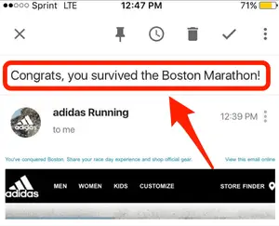
2. Digital Communication – case study
Adidas Boston Marathon
The 2013 bombing at the Boston Marathon killed three people and injured many more.
Adidas had sent an email congratulating runners
who had ‘survived’ the marathon.
Although the company apologised for the poorly
worded email, customers were not impressed!

Slide 14
Remember:
When people are online, they sometimes feel invisible – they may do/say things they would never do/say in public. This includes business owners!

Slide 15
GET BUSY
Practical tips for effective digital communication
Remember you are the ambassador for your business – be professional and polite
Plan your communications – use your online calendar and free tools like Hootsuite
Keep focused – is your online activity productive?
Acknowledge any material designed by others e.g. photos/graphics. Plagiarism is not allowed!
Do you know what the best social media tools are for your business? Facebook might be more suitable than Twitter. See Unit on Digital Skills)

Slide 16
3. Communicating Effectively
Effective face-to-face communication is very important, even for digital entrepreneurs!
You may need to make a presentation or pitch for funding. Or you may be asked to take part in panel discussions on broadcast media.
Delivering presentations or speaking in public can be nerve-wracking but there are some simple tips to help you prepare.

Slide 17
GET BUSY
Practical tips for effective public speaking
Know your audience – what do they want to hear from you?
Prepare an Elevator Pitch
Be able to explain your business model clearly
Know your figures
Tell your audience why you are different from your competitors
Show your passion for your business – share your story!

Slide 18
3. What is an Elevator Pitch?
An Elevator Pitch is a brief way of introducing you and your business – it makes 1-2 key points and is a way of connecting with someone. It should be approximately 30 seconds.
It should be short yet persuasive and memorable.
It’s called an Elevator Pitch because it should take the same amount of time that you would spend travelling in an elevator with someone.
Introduce yourself
Summarise what you do
Explain clearly what you want
Call to action e.g. arrange a meeting

Slide 19
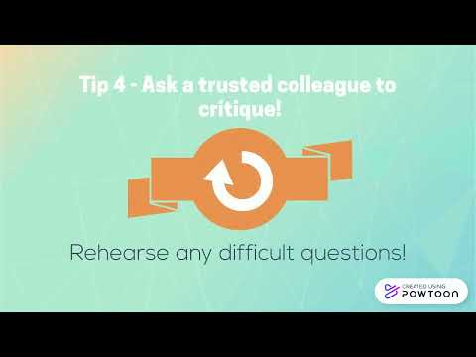

Slide 20
Summing up
Business Communication
Business Communication Planning
Types of Communication
Being Effective
Write your communications plan
Digital Communication
Communicating Effectively
Public Speaking
The Elevator Pitch

Slide 21
Thank you!
dewproject.eu

